Slide 1


Yogesh Kissoondary
August 2022

Slide 2

Outline
Executive Summary
Introduction
Methodology
Results
Conclusion
Appendix

Slide 3
Executive Summary
Summary of methodologies
Data Collection using API and Web Scraping
Exploratory Data Analysis using SQL
Exploratory Data Analysis using Data Visualization
Interactive Visual Analytics with Folium
Interactive Visual Analytics with Dashboard
Machine Learning Prediction
Summary of all results
Exploratory Data Analysis
Interactive analytics in Dashboard
Predictive Analytics using different algorithms

Slide 4
Introduction
Project background and context
Space X advertises Falcon 9 rocket launches on its website with a cost of 62 million dollars; other providers cost upward of 165 million dollars each, much of the savings is because Space X can reuse the first stage. Therefore, if we can determine if the first stage will land, we can determine the cost of a launch. The goal of the project is to create a machine learning pipeline to predict if the first stage will land successfully.
Problems you want to find answers
The factors affect the successful landing of the rocket
The interaction of various features that determine the success rate of a successful landing.
The operating conditions assist the successful landing

Slide 5

Section 1

Slide 6
Methodology
Executive Summary
Data collection methodology:
Data was collected using SpaceX API and web scraping from Wikipedia
Perform data wrangling
Clean data to be suitable for exploratory data analysis and machine learning.
Perform exploratory data analysis (EDA) using visualization and SQL
Perform interactive visual analytics using Folium and Plotly Dash
Perform predictive analysis using classification models
How to build, tune, evaluate classification models

Slide 7
Data Collection
The data was collected using various methods
Data was collected using get request to the SpaceX API.
using .json() and .json_normalize(), the response content is turned to a pandas dataframe.
The missing values are examined and replace with the appropriate values
A web scraping from Wikipedia for Falcon 9 launch records is performed with BeautifulSoup.
Using the BeautifulSoup, the HTML tables are parsed and converted to pandas dataframe.

Slide 8
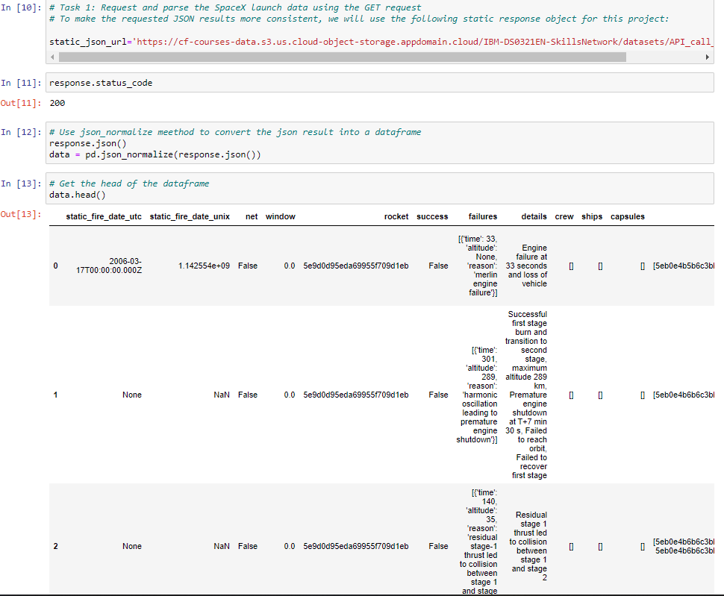
Data Collection – SpaceX API
get request to the SpaceX API is used to collect data, clean the requested data and did some data wrangling and formatting
https://github.com/yogeshsurf/IBM-Data-Science-Capstone/blob/59e95ac43ab100e44bad4953a73e9e3b71cfe6f7/Collecting%20the%20data.ipynb

Slide 9
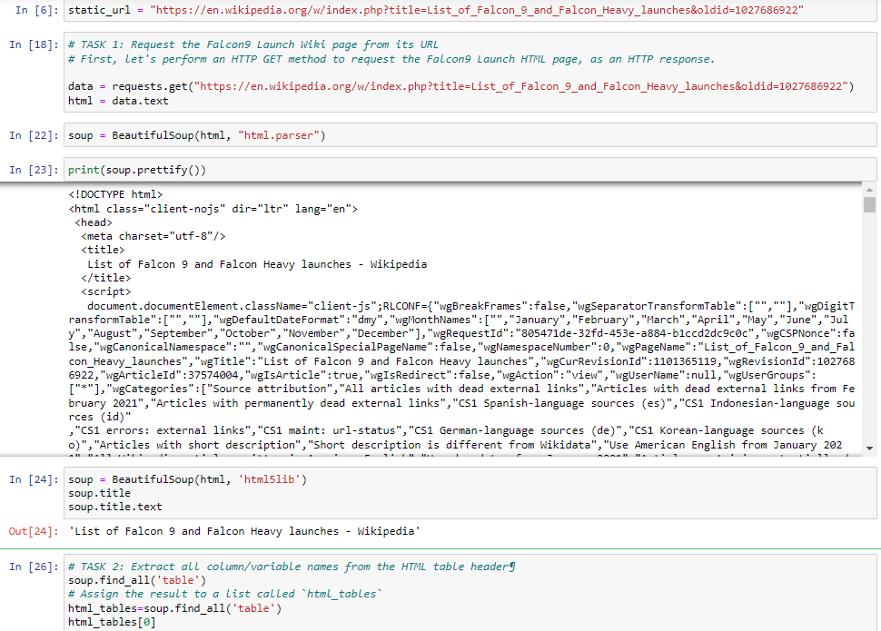
Data Collection - Scraping
A web scraping from Wikipedia for Falcon 9 launch records is performed with BeautifulSoup.
Using the BeautifulSoup, the HTML tables are parsed and converted to pandas dataframe.
https://github.com/yogeshsurf/IBM-Data-Science-Capstone/blob/59e95ac43ab100e44bad4953a73e9e3b71cfe6f7/Web%20scraping%20Falcon%209%20and%20Falcon%20Heavy%20Launches%20Records%20from%20Wikipedia.ipynb

Slide 10
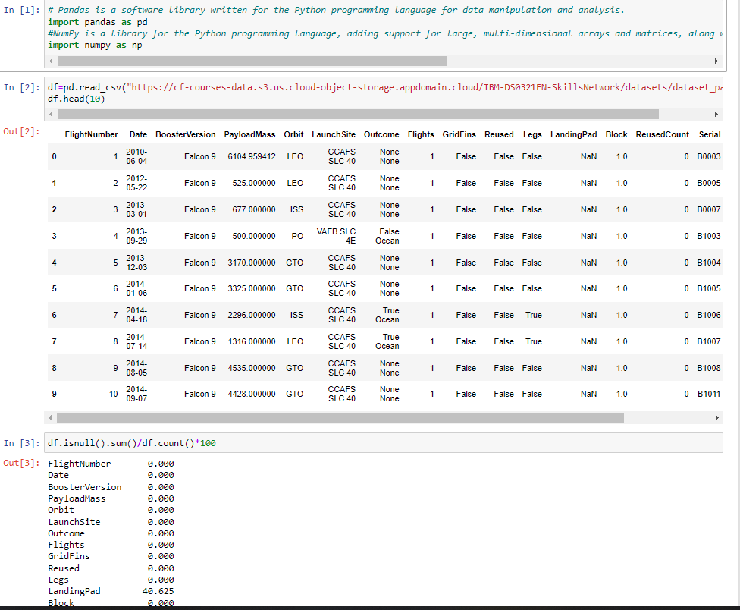
Data Wrangling
Using the Pandas and Numpy libraries:
The data is cleaned and duplication and missing values are examined
Missing values are replaced with the appropriate values
https://github.com/yogeshsurf/IBM-Data-Science-Capstone/blob/59e95ac43ab100e44bad4953a73e9e3b71cfe6f7/Data%20wrangling.ipynb

Slide 11
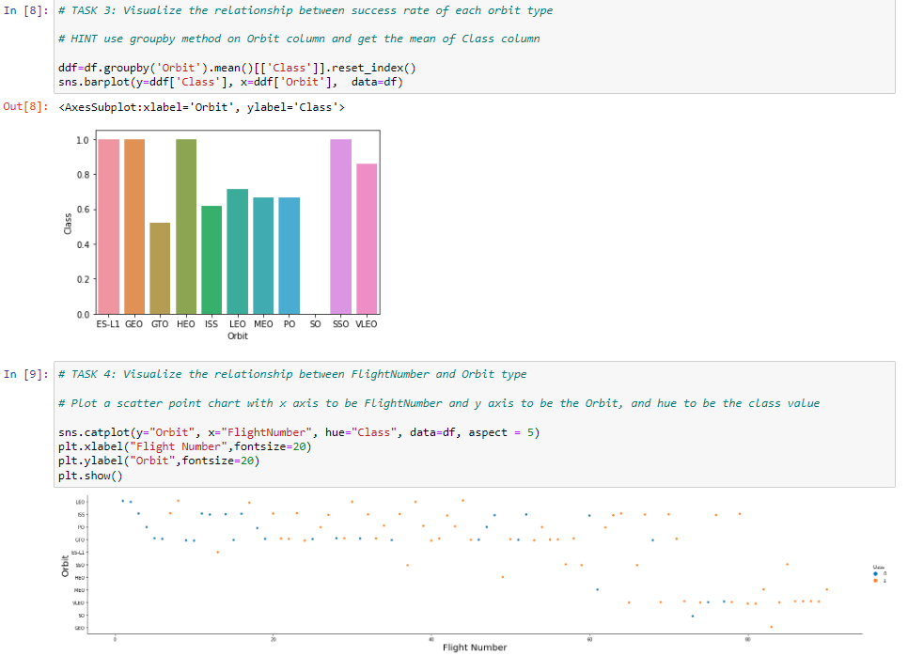
EDA with Data Visualization
The data is explored by visualizing the relationship between flight number and launch Site, payload and launch site, success rate of each orbit type, flight number and orbit type, the launch success yearly
https://github.com/yogeshsurf/IBM-Data-Science-Capstone/blob/888d3535a92af0062d5fd7777e18ebbf14d708ff/Exploring%20and%20Preparing%20Data.ipynb

Slide 12
EDA with SQL
The SpaceX dataset is used with MYSQL database
Different queries are examined using SQL magic function in Jupyter.
The queries include:
The names of unique launch sites in the space mission.
The total payload mass carried by boosters launched by NASA (CRS)
The average payload mass carried by booster version F9 v1.1
The total number of successful and failure mission outcomes
The failed landing outcomes in drone ship, their booster version and launch site names.
https://github.com/yogeshsurf/IBM-Data-Science-Capstone/blob/b191e0b795a878cfe76a71eb8fdf44f8e22722b9/SQL%20Notebook%20for%20Peer%20Assignment.ipynb

Slide 13
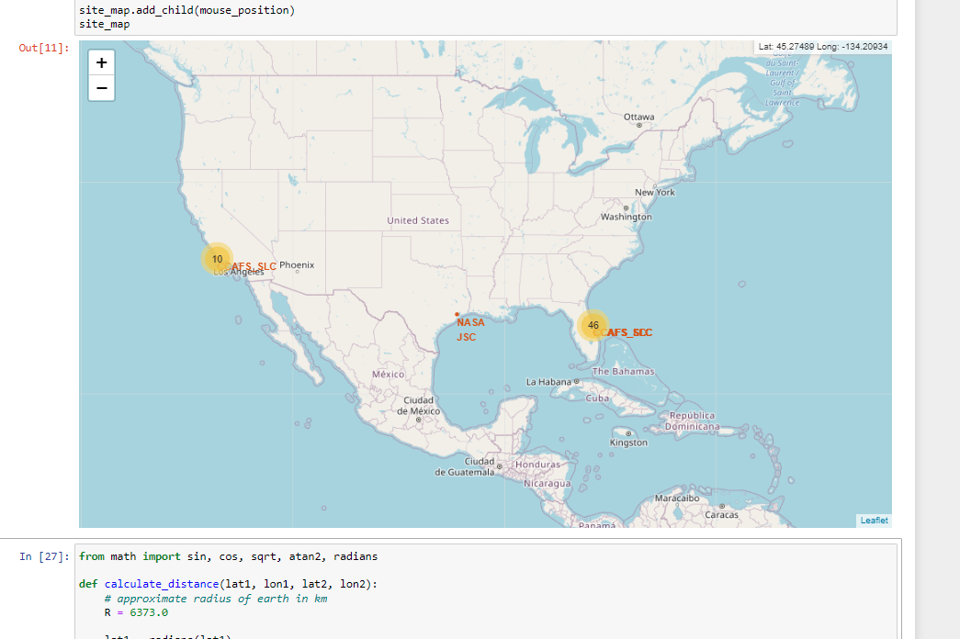
Build an Interactive Map with Folium
All launch sites are explained on map with adding objects such as markers, circles, lines to mark the success or failure of launches for each site.
An assignment of failure or success on each site is differentiate by color .
The distances between a launch site to its proximities to railway, high-way and coasts are explained.
https://github.com/yogeshsurf/IBM-Data-Science-Capstone/blob/61b288474ad4d1d12781cc97179bad572403f26a/Launch%20Sites%20Locations%20Analysis%20with%20Folium.ipynb

Slide 14
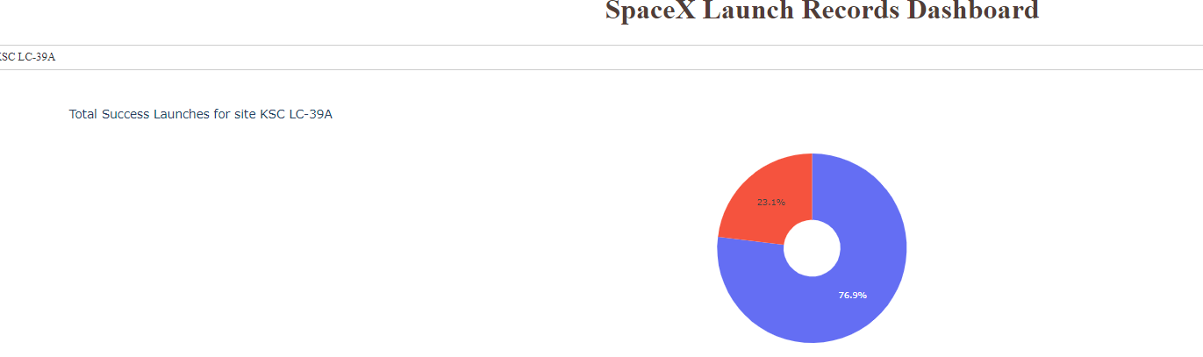
Build a Dashboard with Plotly Dash
a Plotly Dash application for users to perform interactive visual analytics on SpaceX launch data in real-time.
This dashboard application contains input components such as a dropdown list and a range slider to interact with a pie chart and a scatter point chart.
https://github.com/yogeshsurf/IBM-Data-Science-Capstone/blob/84b8c723ae11c784d1d20e3b8857318cb2f54468/Dashboard%20Application%20with%20Plotly%20Dash.ipynb

Slide 15
Predictive Analysis (Classification)
The predictive analysis is started by importing the required packages
Indicating the input data and the output data
Splitting the data into train and test data
Try multiple algorithm to get the best results for the prediction
These algorithms are :
Logistic Regression classification algorithm
Support Vector Machine classification algorithm
Decision Tree classification algorithm
K Nearest Neighbors classification algorithm
https://github.com/yogeshsurf/IBM-Data-Science-Capstone/blob/082da0938a51278f3be03dac0de3570afa3152f6/Machine%20Learning%20Prediction.ipynb

Slide 16
Results
Exploratory data analysis results
Interactive analytics demo in screenshots
Predictive analysis results

Slide 17

Section 2

Slide 18
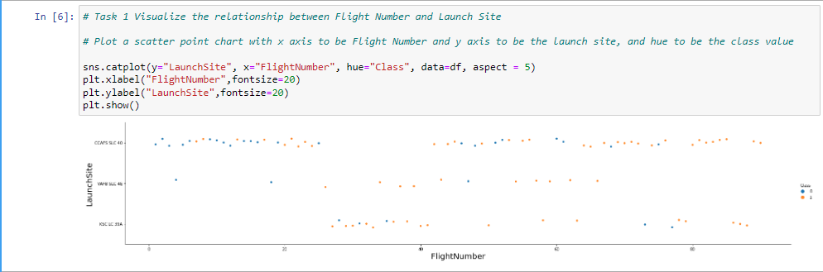
Flight Number vs. Launch Site

Slide 19
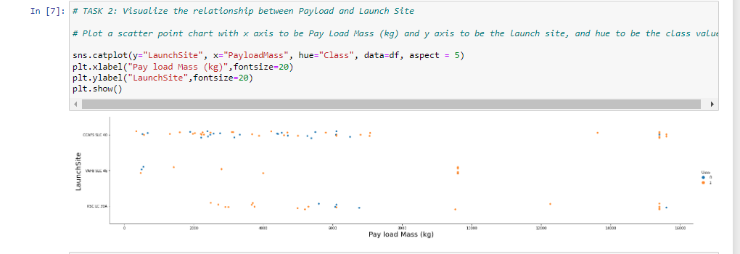
Payload vs. Launch Site

Slide 20
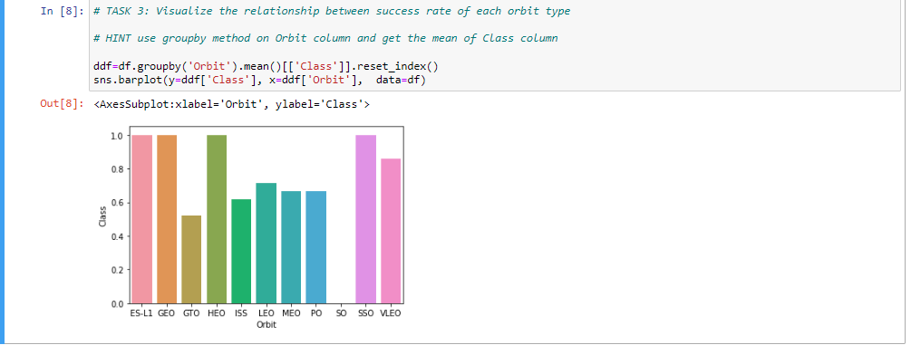
Success Rate vs. Orbit Type

Slide 21
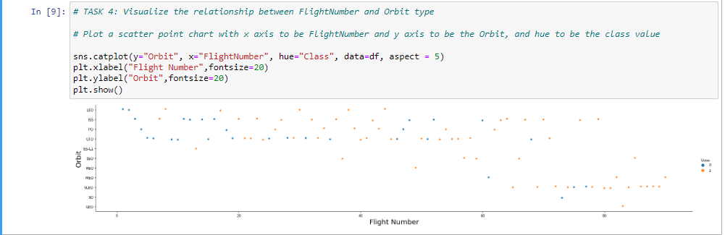
Flight Number vs. Orbit Type

Slide 22
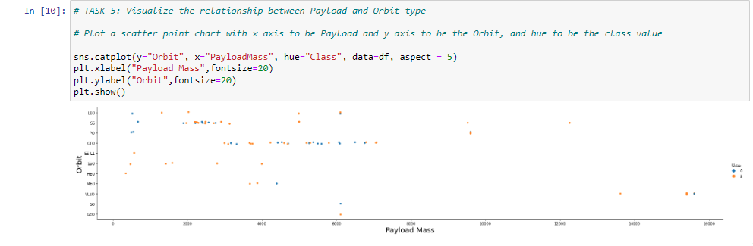
Payload vs. Orbit Type

Slide 23
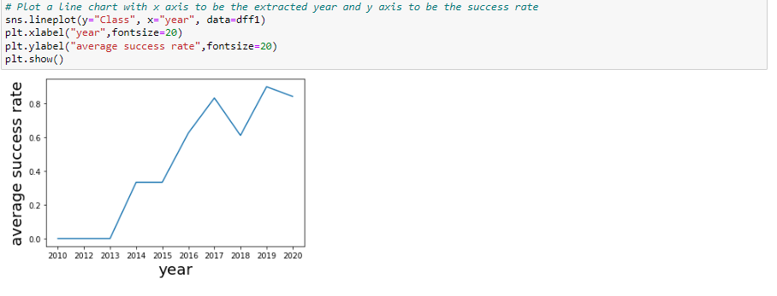
Launch Success Yearly Trend

Slide 24
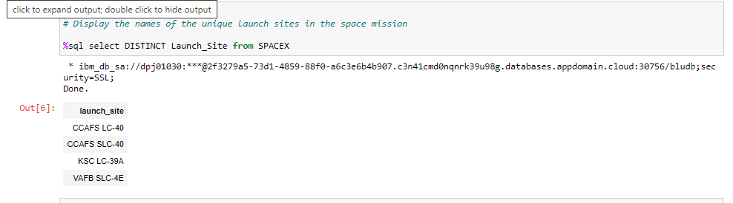
All Launch Site Names

Slide 25
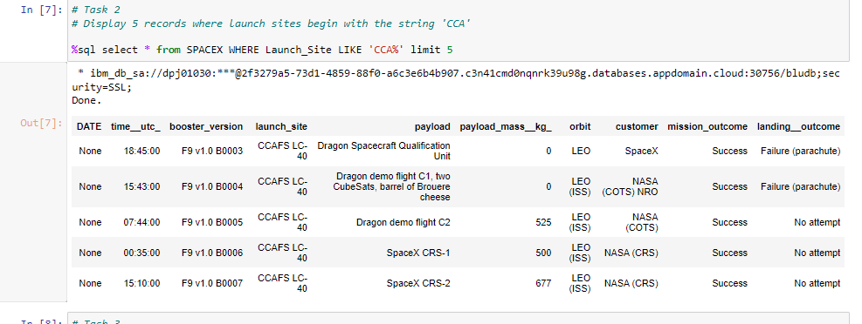
Launch Site Names Begin with 'CCA'

Slide 26
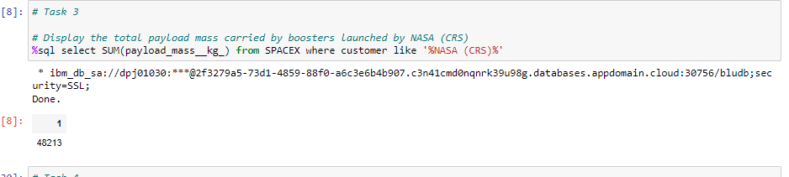
Total Payload Mass
Calculate the total payload carried by boosters from NASA

Slide 27
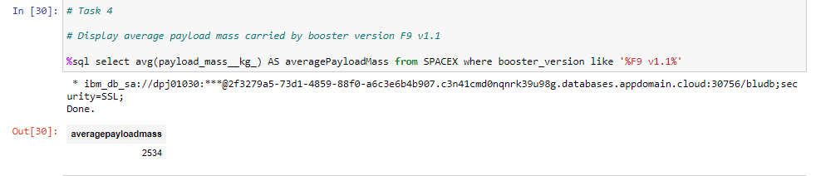
Average Payload Mass by F9 v1.1

Slide 28
First Successful Ground Landing Date
Find the dates of the first successful landing outcome on ground pad
Present your query result with a short explanation here

Slide 29
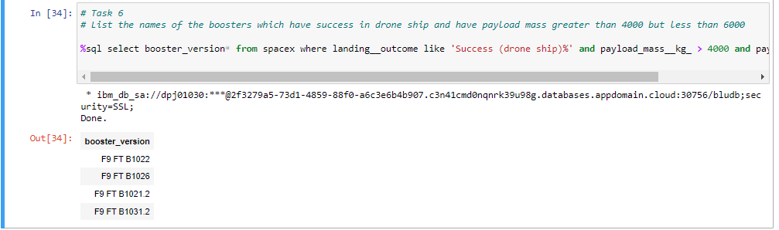
Successful Drone Ship Landing with Payload between 4000 and 6000

Slide 30
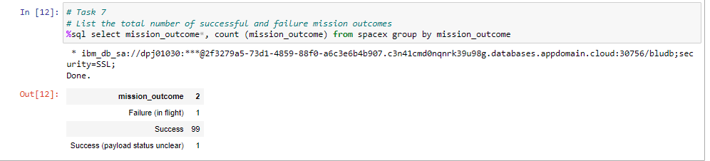
Total Number of Successful and Failure Mission Outcomes

Slide 31
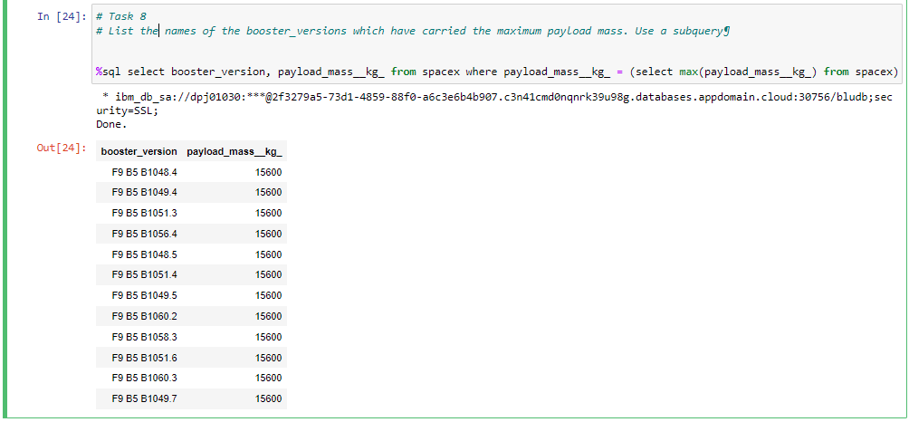
Boosters Carried Maximum Payload

Slide 32
2015 Launch Records
The date format is showing as none when uploaded. I tried a few combination and unfortunately it is not working

Slide 33
Rank Landing Outcomes Between 2010-06-04 and 2017-03-20
The date format is showing as none when uploaded. I tried a few combination and unfortunately it is not working

Slide 34

Section 3

Slide 35
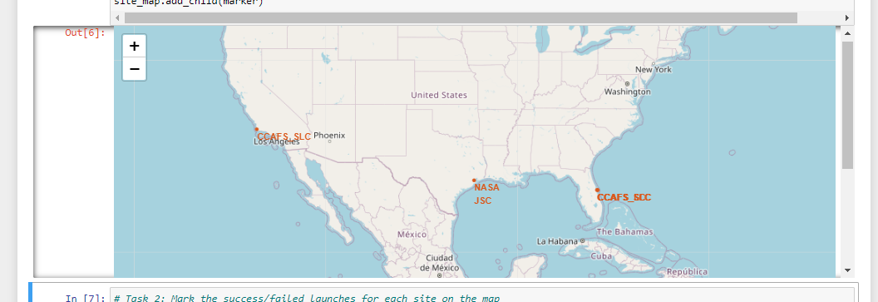
<Folium Map Screenshot 1>

Slide 36
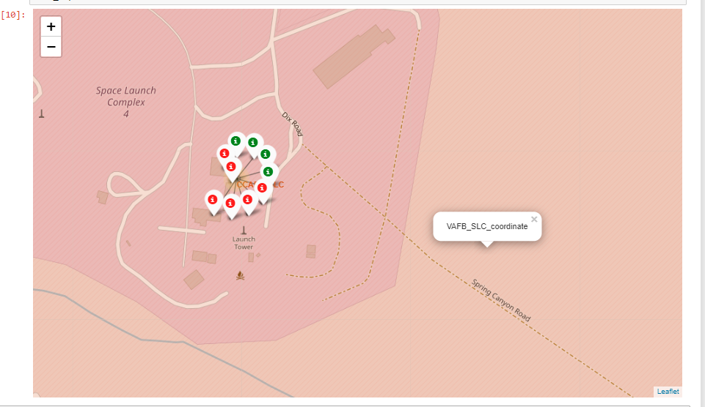
<Folium Map Screenshot 2>

Slide 37
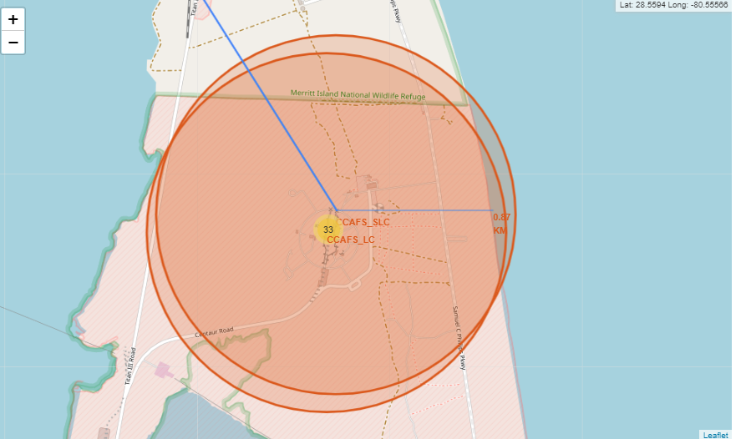
<Folium Map Screenshot 3>

Slide 38

Section 4

Slide 39
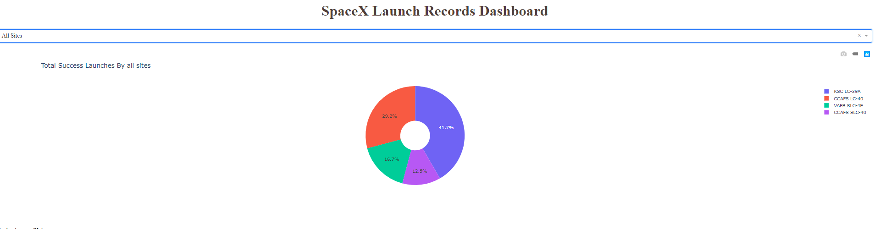
<Dashboard Screenshot 1>

Slide 40
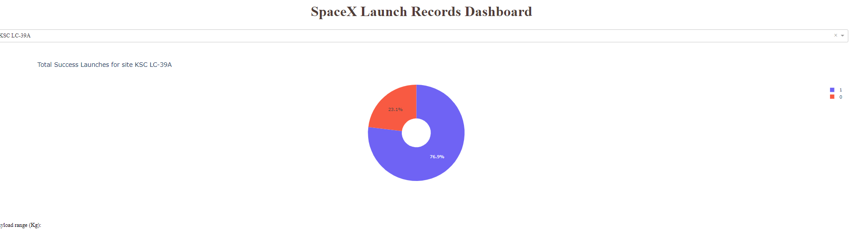
<Dashboard Screenshot 2>

Slide 41
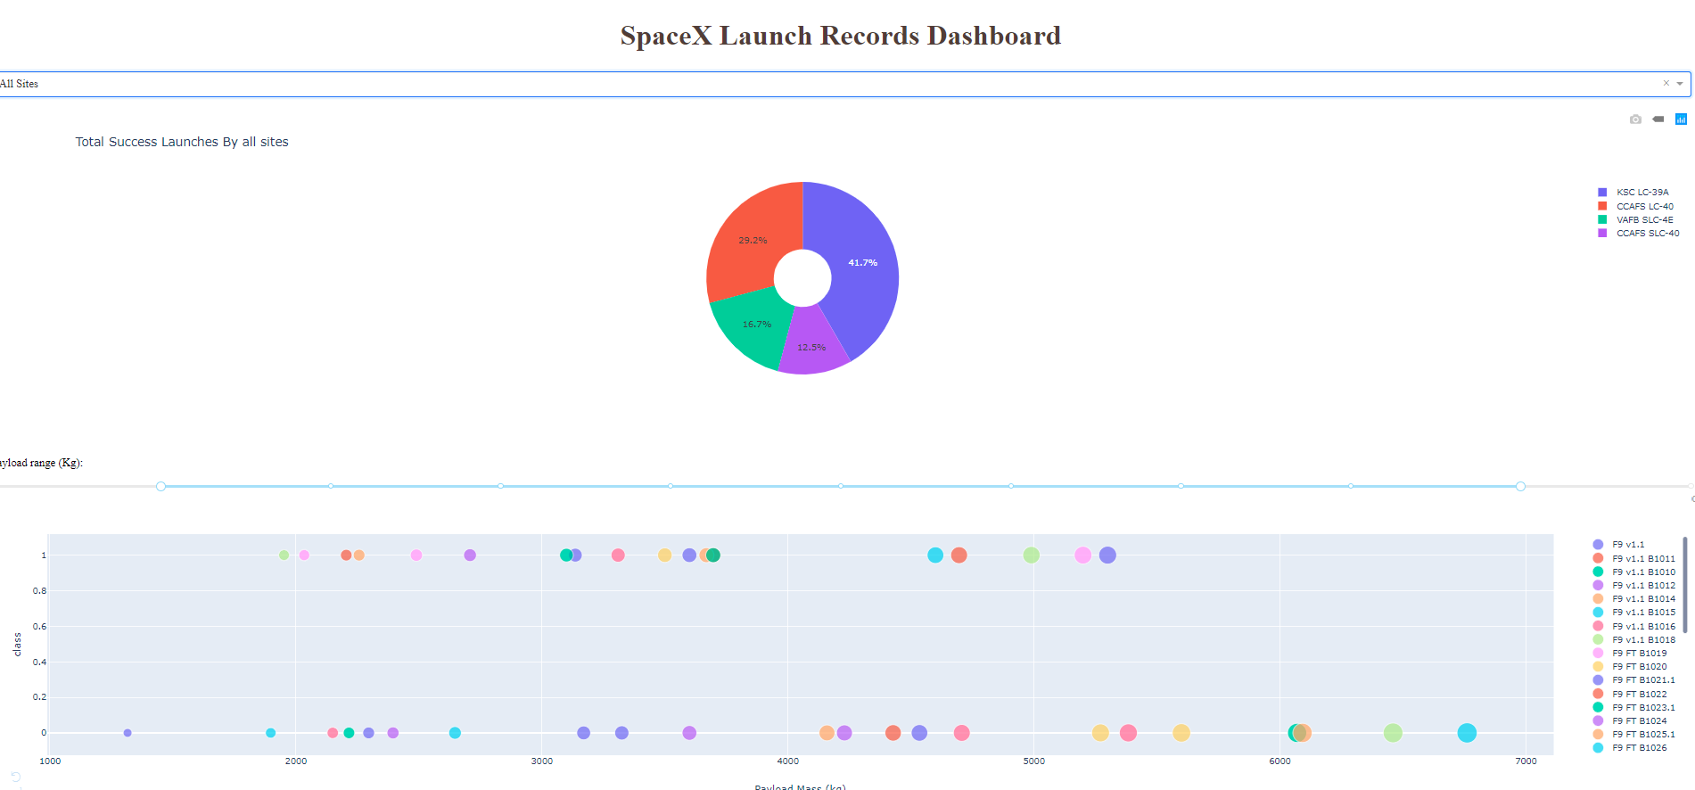
<Dashboard Screenshot 3>

Slide 42

Section 5

Slide 43
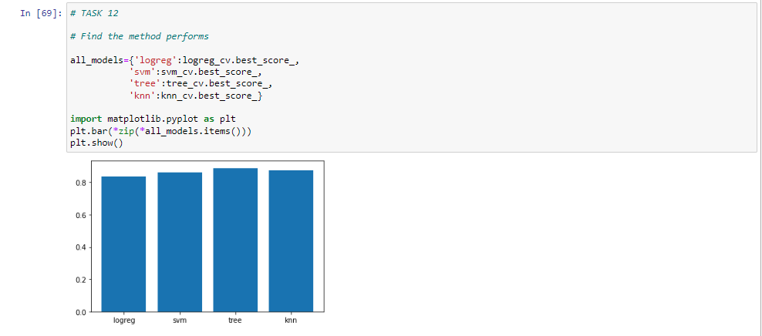
Classification Accuracy
It can be shown that the Decision tree has the best accuracy

Slide 44
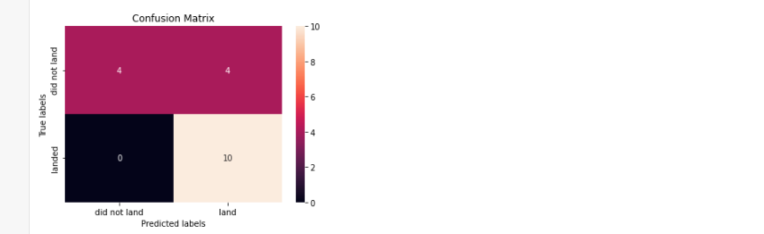
Confusion Matrix
the Decision tree has the best accuracy

Slide 45
Conclusions
Launch success rate started to increase in 2013 till 2020.
Orbits ES-L1, GEO, HEO and SSO have the most success rate.
KSC LC-39A had the most successful launches of any sites.
The Decision tree classifier is the best machine learning algorithm for this task.

Slide 46


